Slide 1
GEOG-G489/589 Python Programming
Instructor: Natasha MacBean
Loops (and extra Pandas)

Slide 2
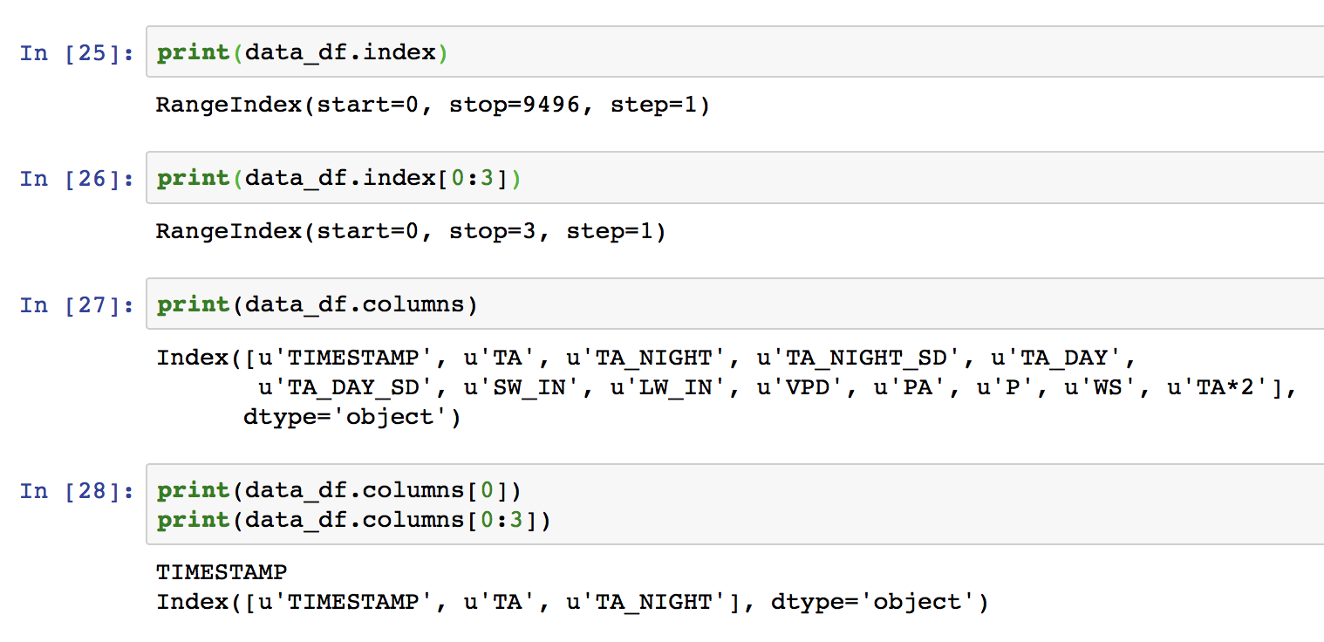
Accessing the column and row (index) names

Slide 3
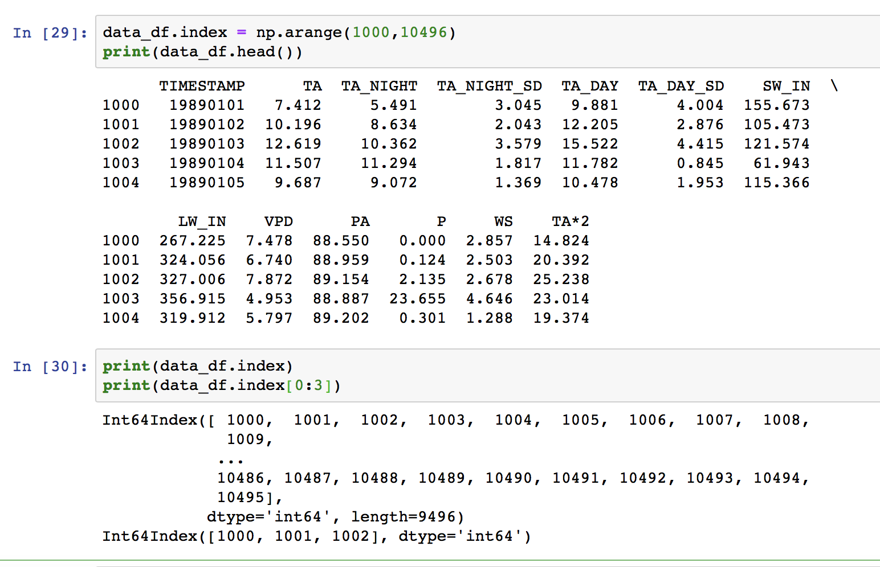
Changing the index values

Slide 4
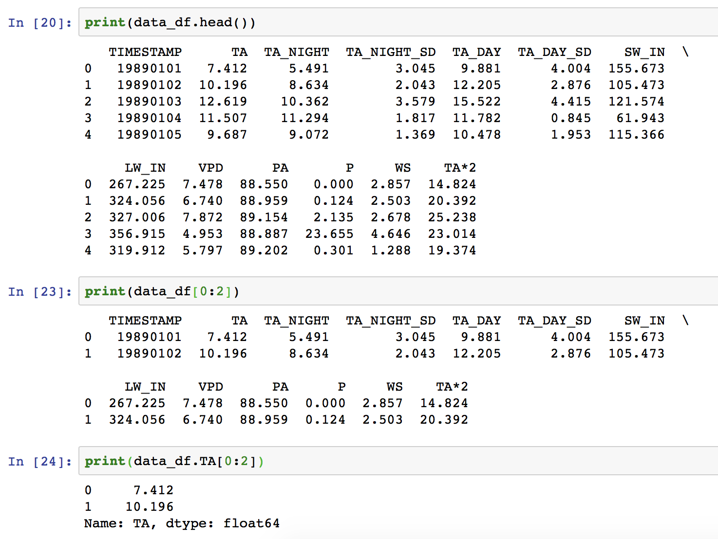
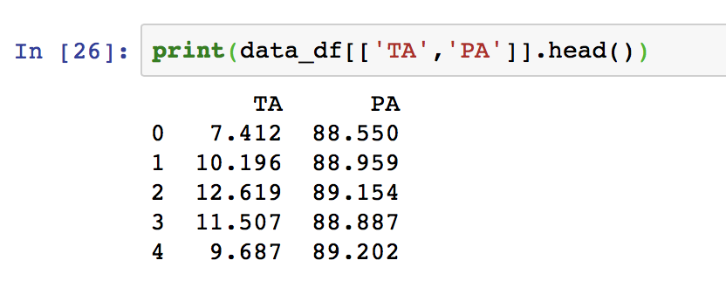
Pandas recap: indexing by columns and row slices using square brackets
Slice of rows
Slice of rows for “TA” column
Selecting multiple columns

Slide 5
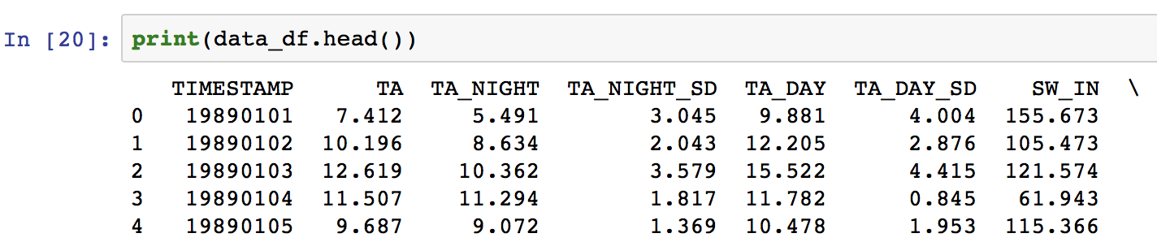
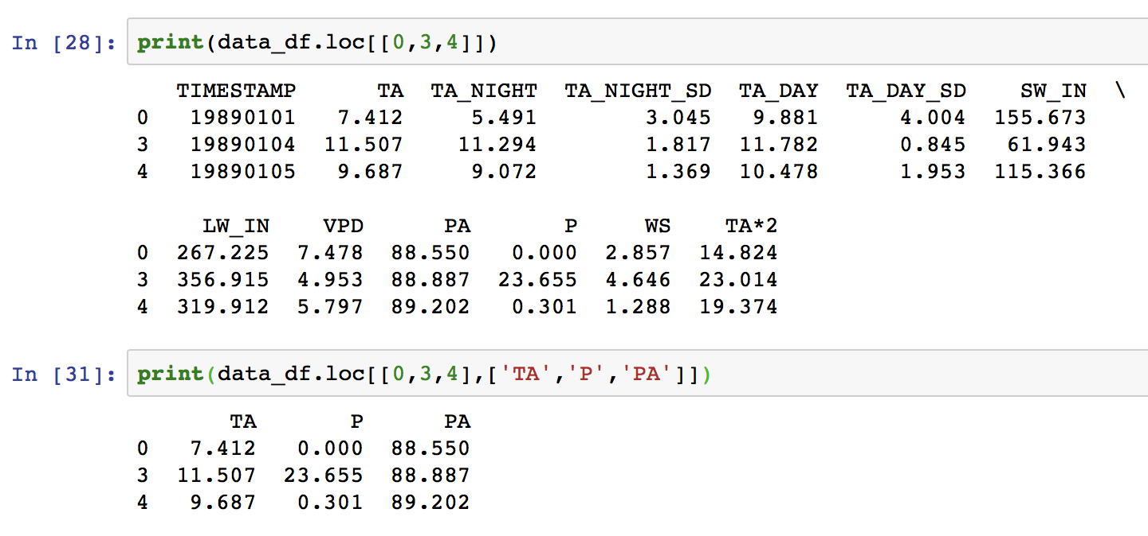
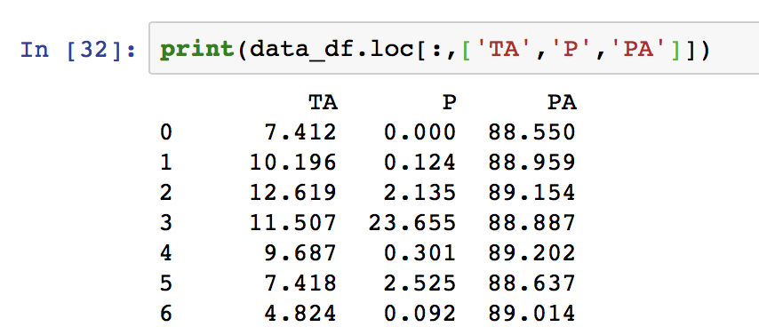
Pandas: indexing by specific row and column labels with loc
Selecting 1st, 4th and 5th rows → all columns
Selecting specific rows and columns
Selecting all rows for specific columns

Slide 6
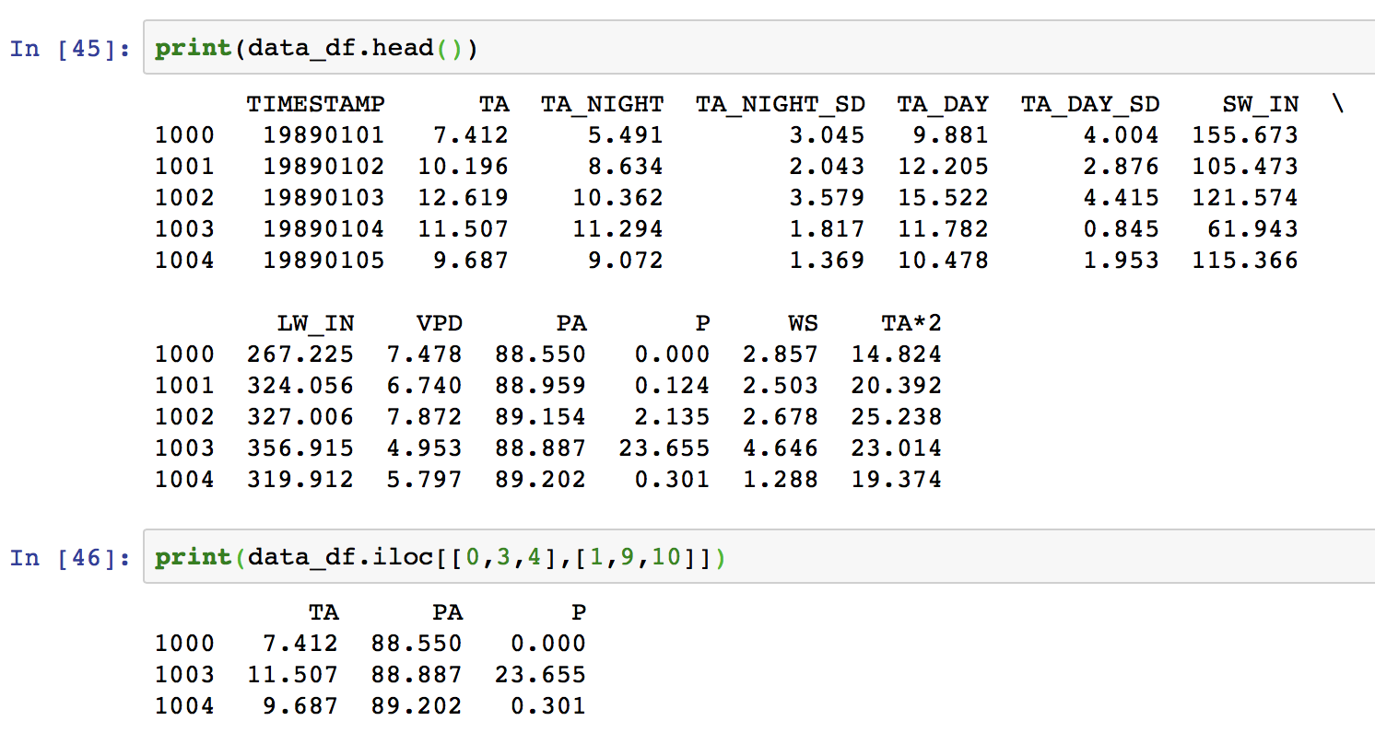
Pandas: indexing by specific row and column labels with iloc
Selecting specific rows and columns just by their index

Slide 7
Pandas: indexing
Square brackets
Column access: data_df[[“TA”, “VPD”]]
Row access only through slicing: data_df[1:4]
loc (label-based)
Column access: data_df.loc[:, [“TA”, “VPD”}]
Row access: data_df[[“1000”, “1003”, “1010”]]
Row & Column access: data_df.loc[[“1000”, “1003”, “1010”], [“TA”, “VPD”]]
iloc (index-based)
Column access: data_df.loc[:, [1, 8}]
Row access: data_df[[0, 3, 10]]
Row & Column access: data_df.loc[[0, 3, 10], [1, 8]]

Slide 8
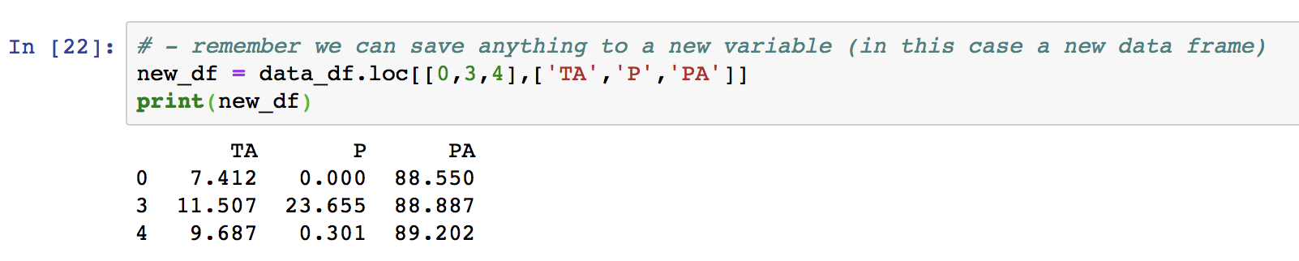
Recap: saving to a new variable

Slide 9
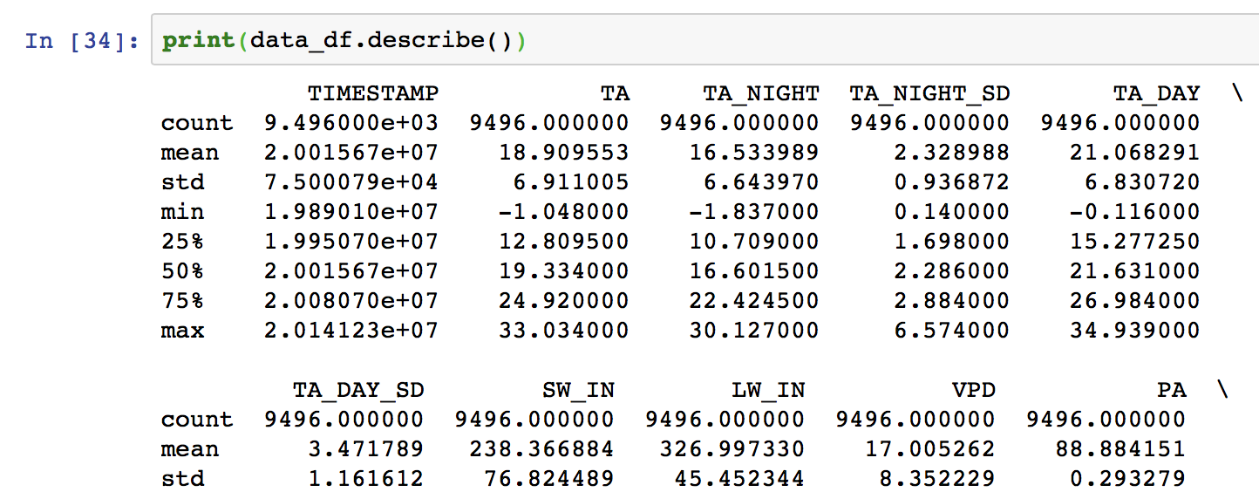
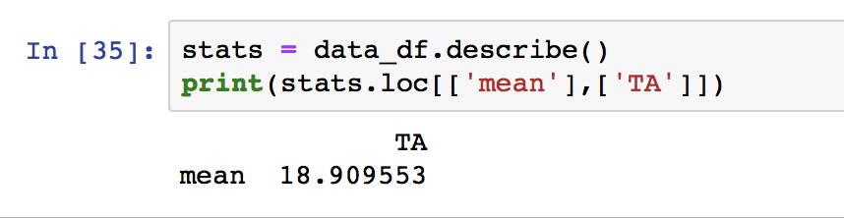
Simple statistics with pandas

Slide 10
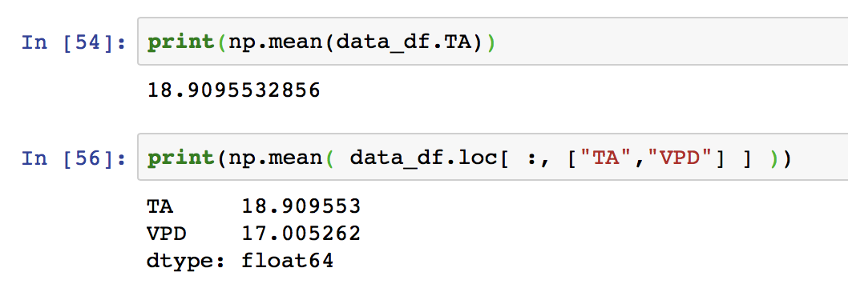
You can also use NumPy functions with pandas series

Slide 11
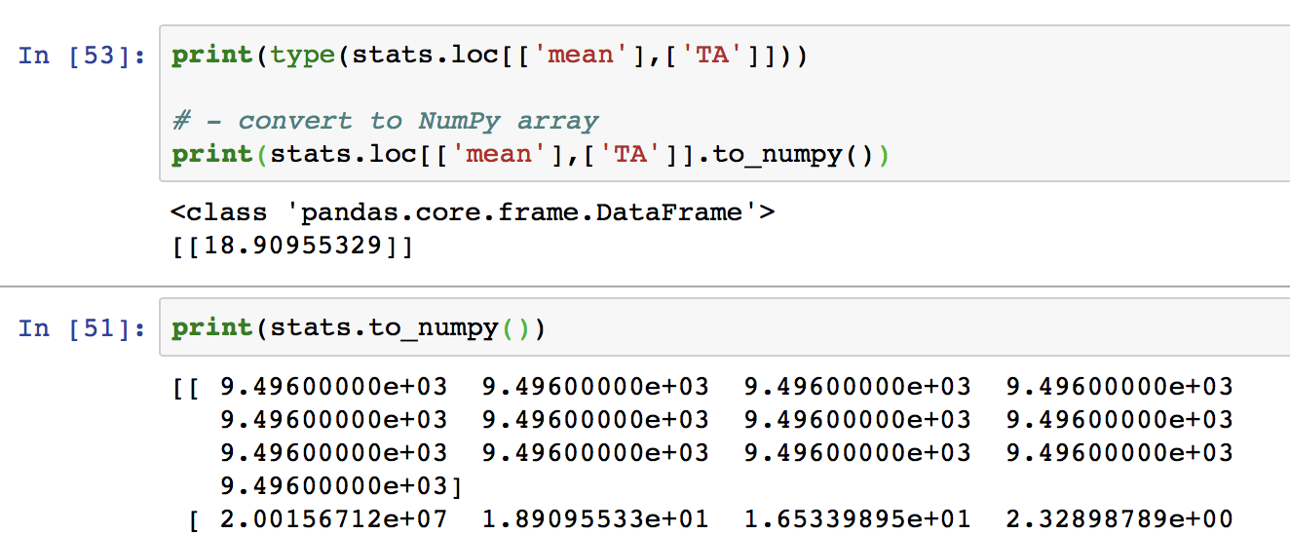
Saving values to a NumPy array

Slide 12
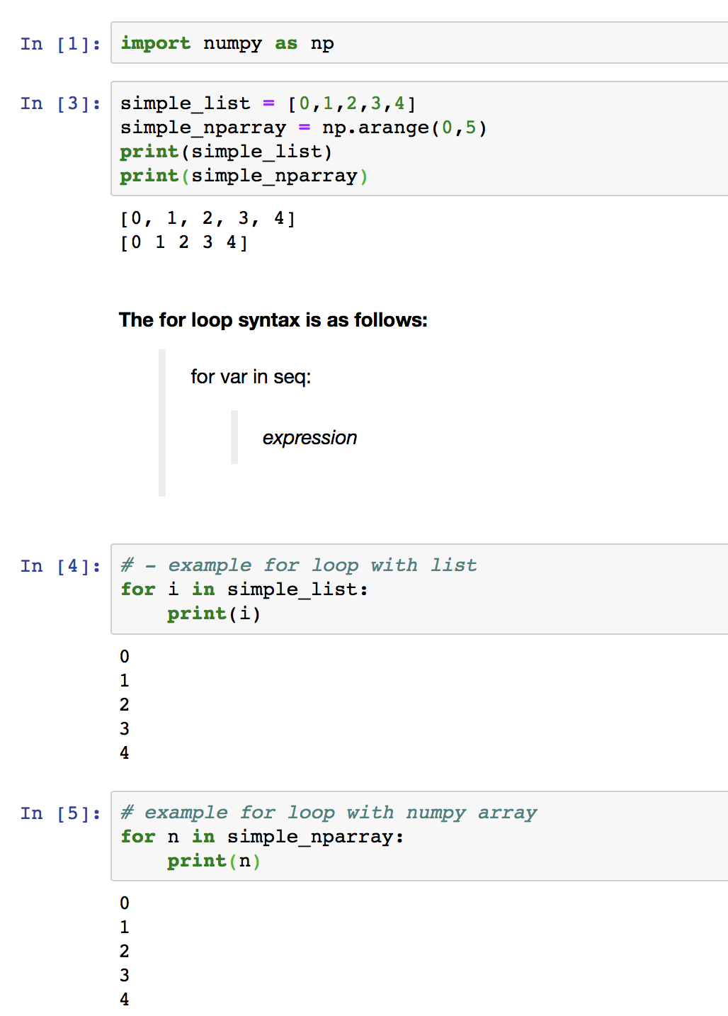
LOOPS: for loop

Slide 13
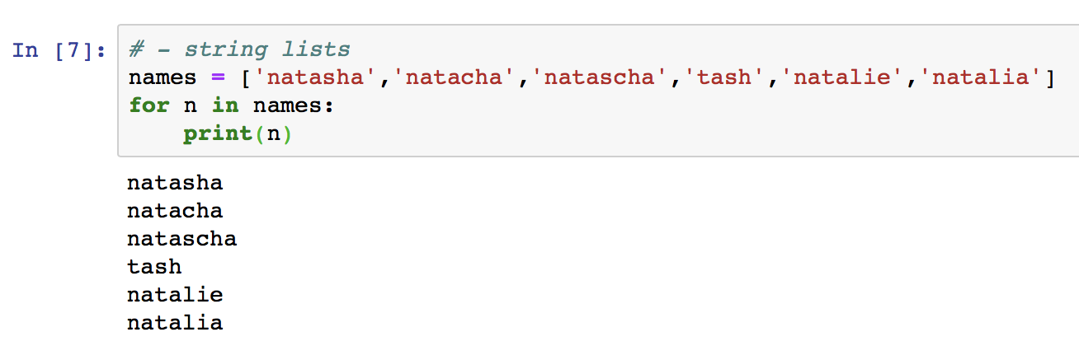
LOOPS: for loop → example with string lists

Slide 14
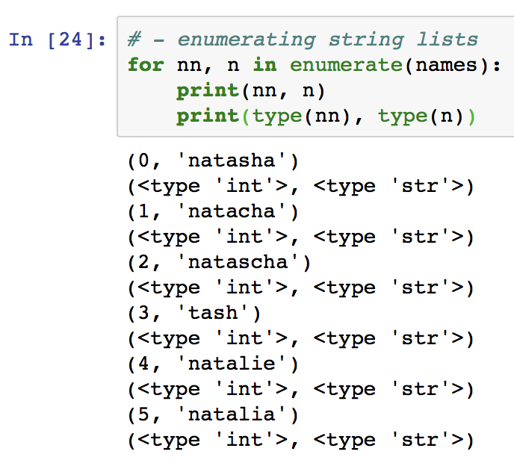
LOOPS: for loop → enumerating string lists

Slide 15
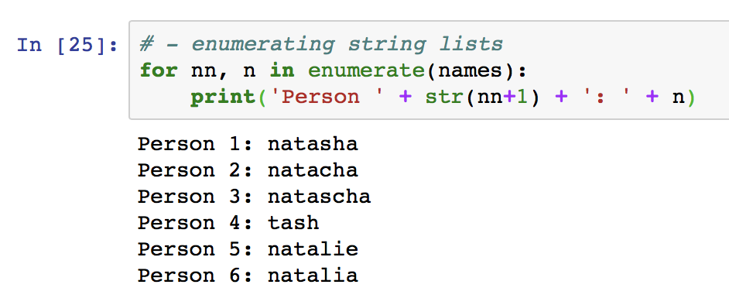
LOOPS: for loop → enumerating string lists

Slide 16
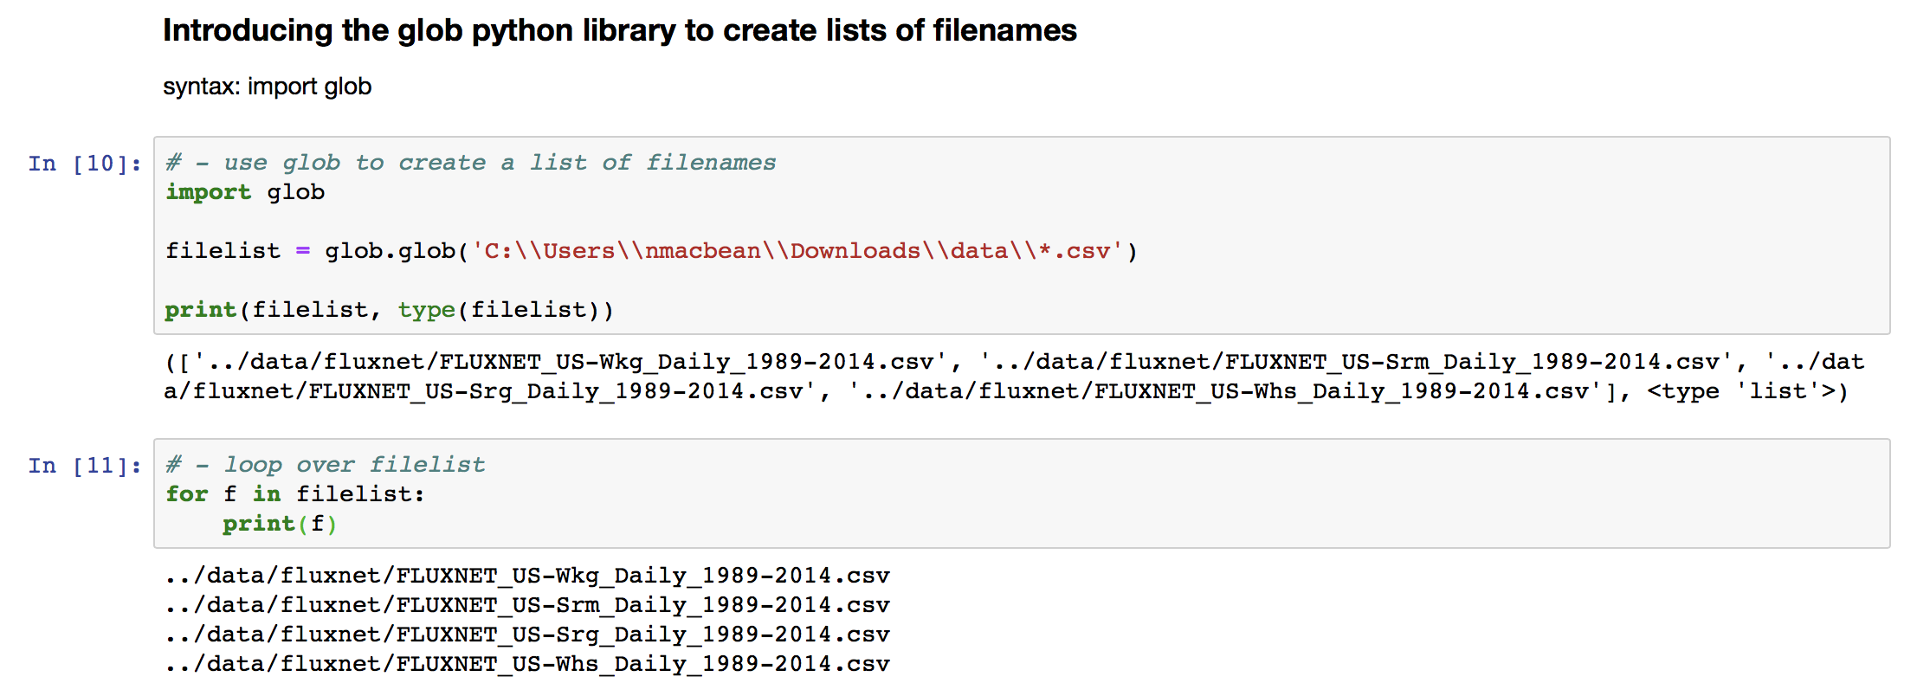
Return to lists for looping → using the glob function
Using the glob library

Slide 17
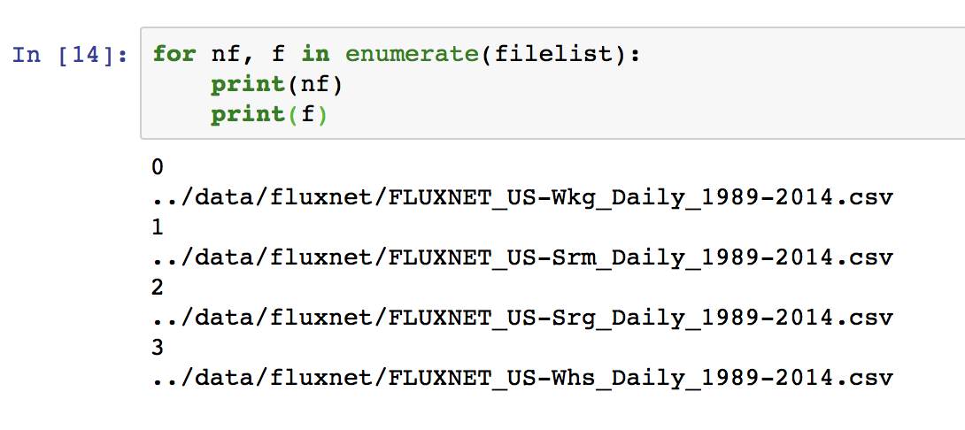
Return to lists for looping → using the glob function
Using the glob library

Slide 18
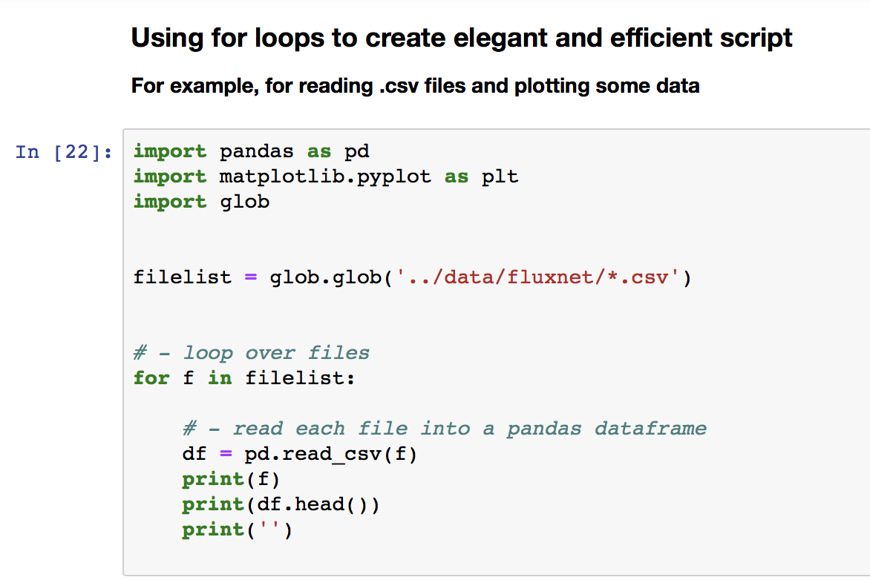
Creating elegant and efficient code using for loops

Slide 19
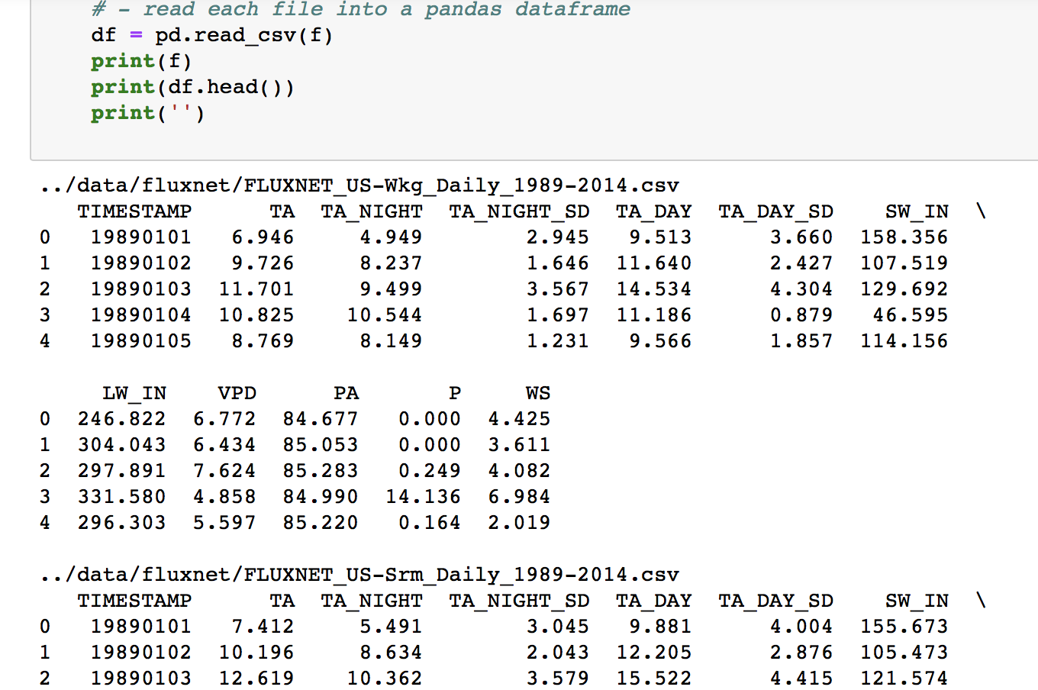
Creating elegant and efficient code using for loops

Slide 20
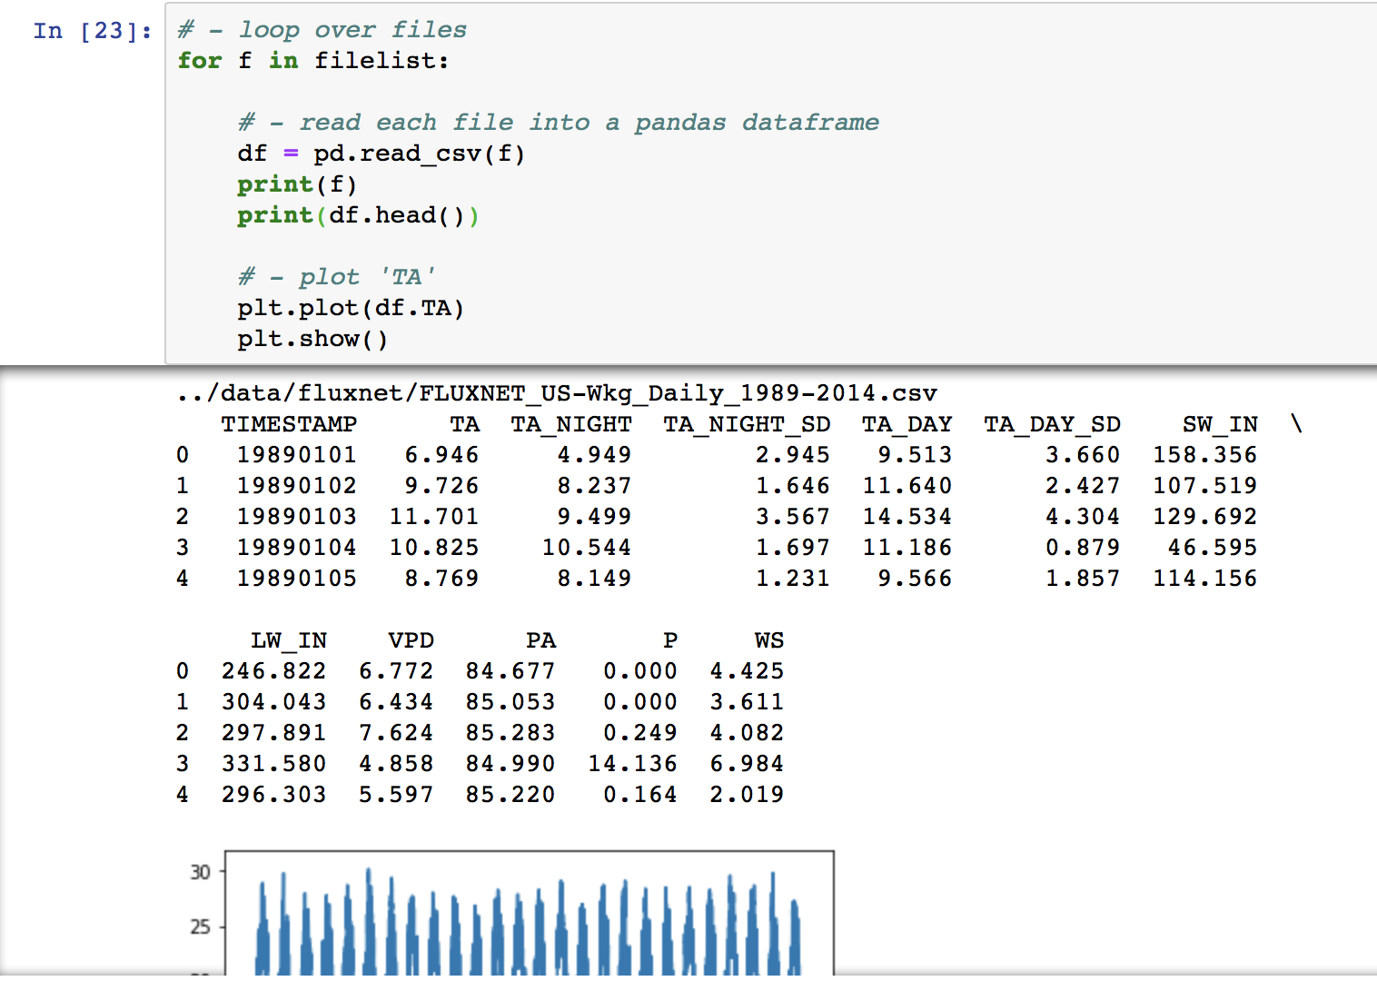
Creating elegant and efficient code using for loops

Slide 21
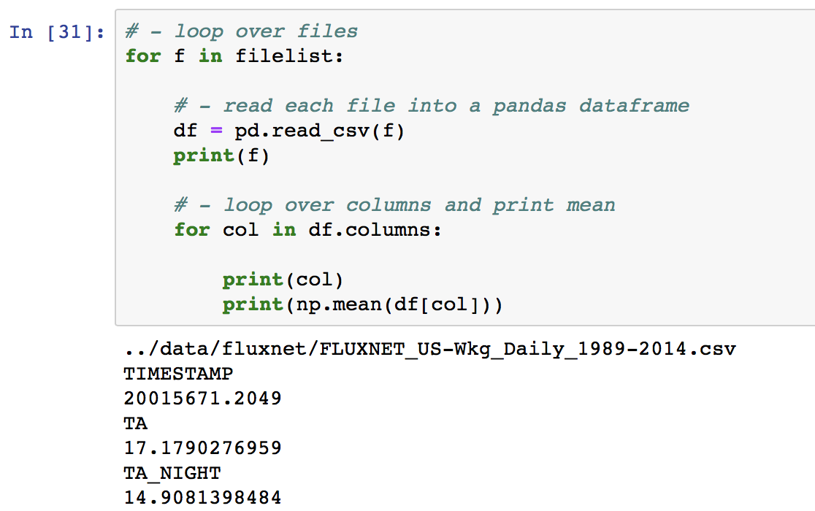
Loops within loops

Slide 22
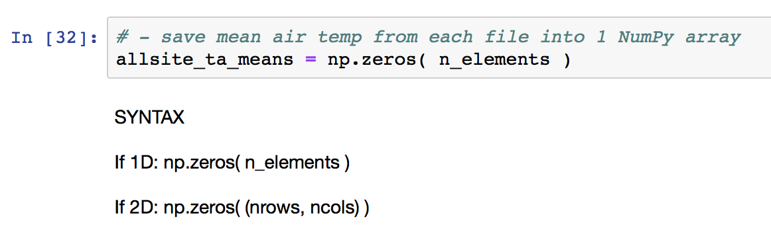
Saving information outside the loop

Slide 23
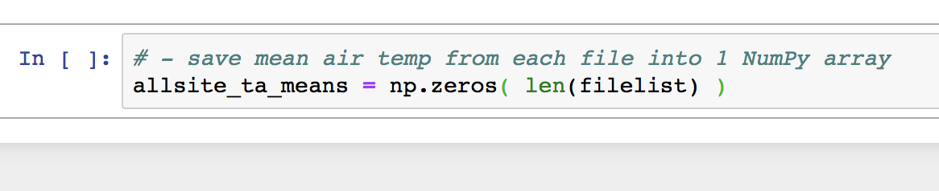
Saving information outside the loop

Slide 24
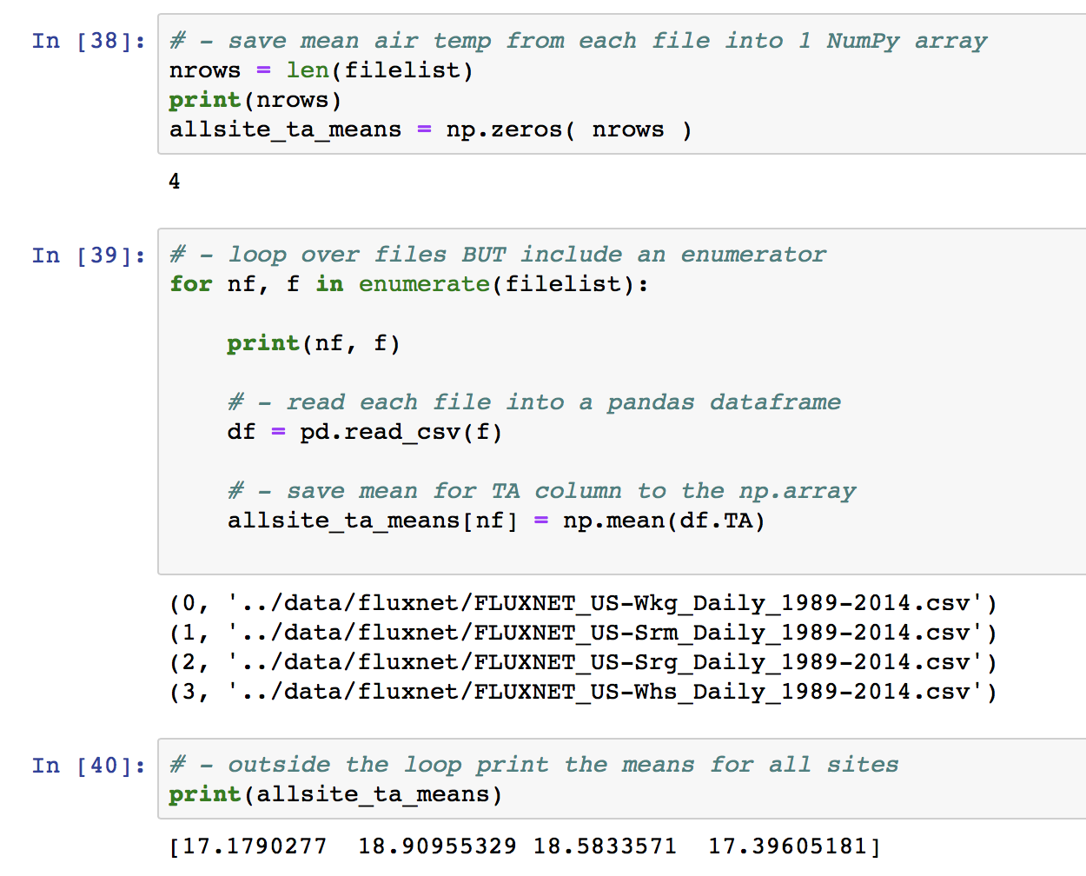
Saving information outside the loop

Slide 25
Today’s in-class exercise
Dowload data.zip → it should contain all 4 files for the 4 Ameriflux sites
Using what we have learned today in class, create a list of the files using glob
Then loop over the files and…
Print the simple descriptive statistics for each site
Still within the loop, calculate (and save to a NumPy array) the total precipitation (column “P”) for each site
Which numpy command will we use for this?
Outside the loop, print out your total precipitation results for all sites.

